Slide 1
Lecture 1: Introduction
June 22nd, 2020

Slide 2
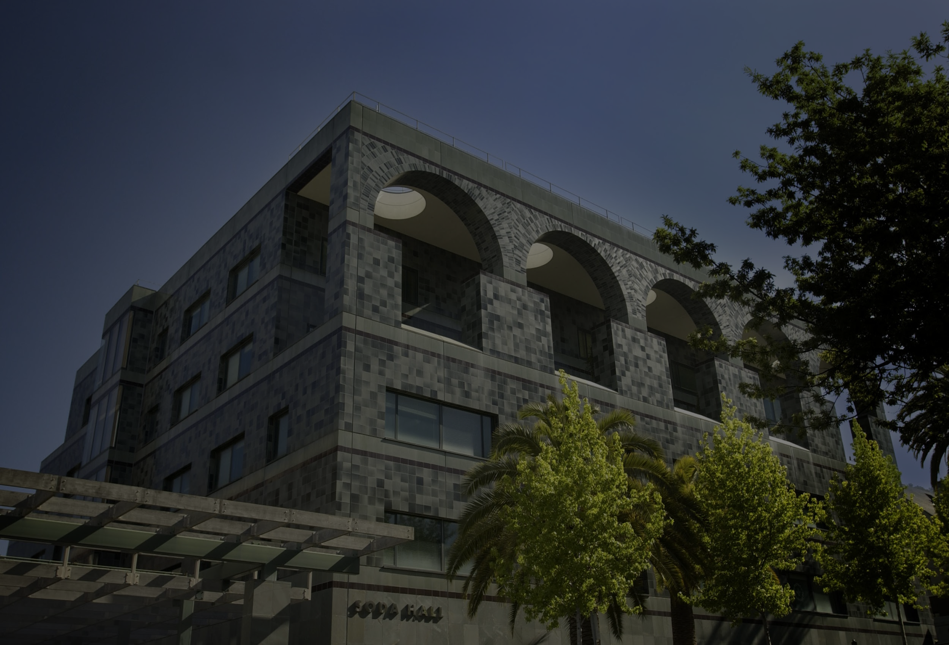
Welcome to CS 61A!

Slide 3

CS61A
λ
720 students
16 timezones

Slide 4
Humans of CS 61A

Slide 5
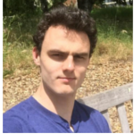
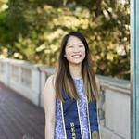
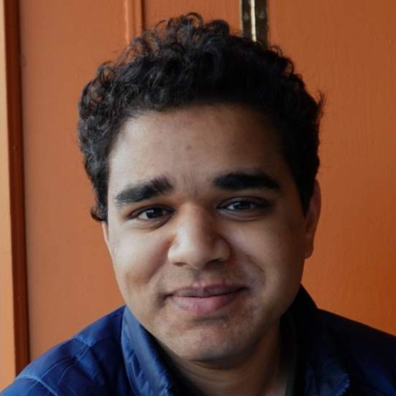
Instructors
Ryan Moughan
rmoughan@berkeley.edu
Chae Park
chae@berkeley.edu
Kavi Gupta
kavi@berkeley.edu

Slide 6
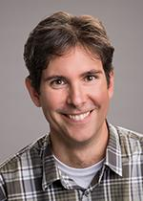
Prof. John DeNero

Slide 7
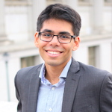



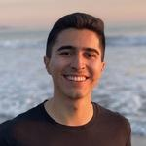

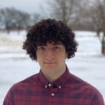
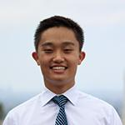
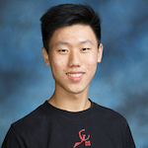


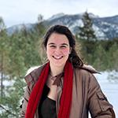

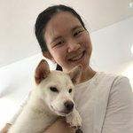
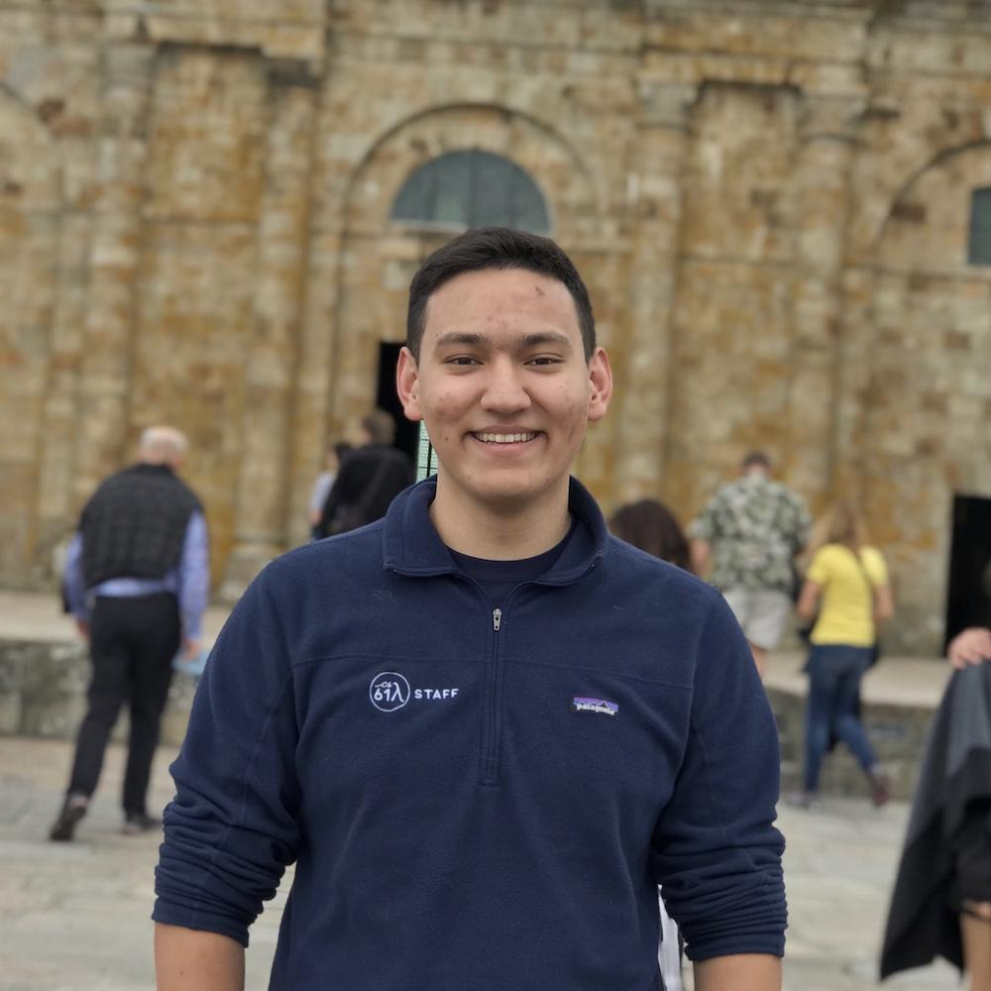

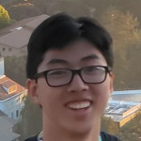
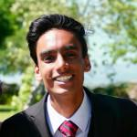
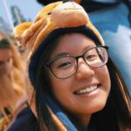
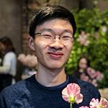
Teaching Assistants

Slide 8
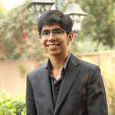
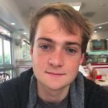
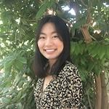
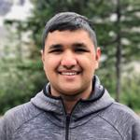
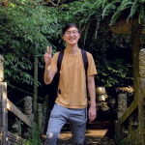
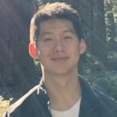
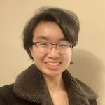
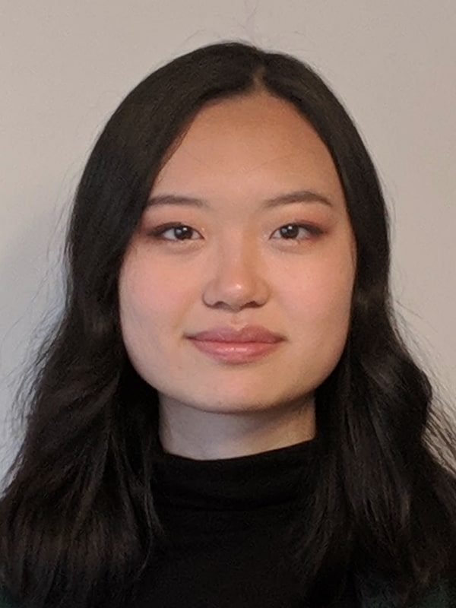


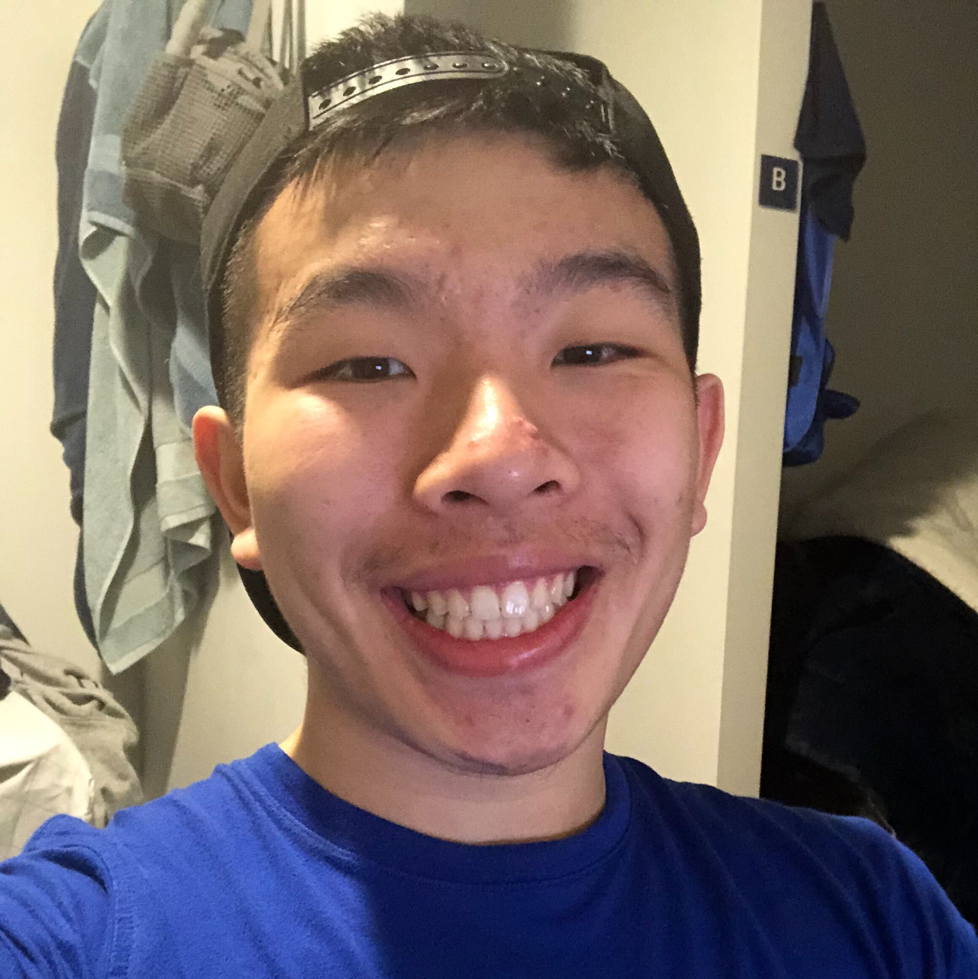
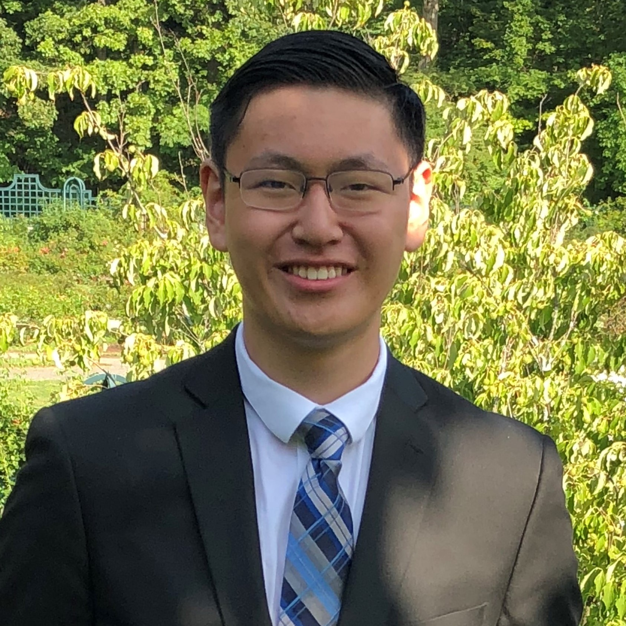
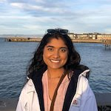

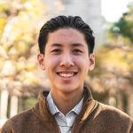

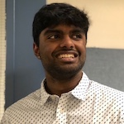
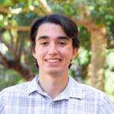
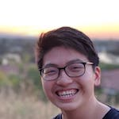

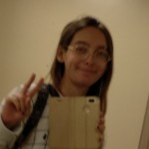
Tutors

Slide 9
You!

Slide 10
Computer Science

Slide 11

What is Computer Science?
What problems can be solved using computation?
How do we solve those problems using computers?
What techniques lead to effective solutions?
Systems
Artificial Intelligence
Graphics
Security
Networking
Programming Languages
Theory
...

Slide 12
What is CS 61A?
A course about managing complexity
Mastering abstraction
Programming paradigms
An introduction to programming
Full understanding of Python fundamentals
Combining multiple ideas in large projects
How computers interpret programming languages
A challenging course that will demand a lot of you

Slide 13

Alternatives to CS 61A
CS 10 The Beauty and Joy of Computing
An introduction to fundamentals (& Python) that sets students up for success in CS 61A
Data 8 The Foundations of Data Science
Fundamentals of computing, statistical inference, & machine learning applied to real-world data sets
cs10.org
data8.org
Notes:
both are available this summer

Slide 14
Course Logistics

Slide 15
Course Format
Lecture Whenever you want!
Lab the most important part of this course
Discussion the most important part of this course
Office hours the most important part of this course
Tutoring the most important part of this course
Textbook composingprograms.com
8 programming homeworks
4 programming projects
1 diagnostic quiz, 1 midterm exam, and 1 final exam
Lots of course support and a great community

Slide 16
The First Week
Lab 0 released today!
Discussion starts tomorrow!
OH starts later this week

Slide 17
Lecture
Main lectures are recorded videos by John Denero
We will be giving supplementary live lectures once a week (details announced later)

Slide 18
Discussion Section
Only part of the course that tracks attendance
90 minute section twice a week
Largely worksheet based (but do not expect to finish it)
Recorded

Slide 19
Office Hours
Three formats: Appointments, Parties, and Instructor
Appointment-based Office Hours:
20 minutes each
Sign up the night before
Some will only be conceptual
Parties:
3 hours each
2 flavors: Homework and Project
Queue-based
Instructor:
Strong focus on concepts and not assignments

Slide 20
Small Group Tutoring Sections
Small-group sections (4-5 students) centered around a worksheet which reviews content from the corresponding discussion
Recurring
Meet twice a week regularly with the same group of students
Sign-ups will open later this week
Start next week
Drop In
Can sign up if you feel like you could use some extra reinforcement on topics presented from the last discussion
Sign-ups will open every end of the week

Slide 21
Tools
Zoom: A platform for video calls
Can ask questions via voice or text-chat
Option to ask questions individually in a “breakout” section
Where discussions , hw/project parties will happen
Piazza
Forum for students to post questions & get announcements from instructors
Various pieces of software
Will introduce most of these in lab00, so complete this ASAP!

Slide 22
Grading
(10) Participation
Diagnostic Quiz (5)
(24) Homework
300
(20) Lab
Midterm (55)
Recovery points
(max 10)
(106) Projects
Final (80)
Notes:
This course is graded on a 300 point scale.

Slide 23
Assignments
You can earn 150 points through assignments:
(10) 2 pt. Twice a week lab assignments
(8) 3 pt. weekly programming homework assignments
(4) 20-30 pt. programming projects
Most assignments are submitted using Ok (okpy.org).
You must have an @berkeley.edu address listed as your primary email on CalCentral to be enrolled on Ok.
If you have not been added to OK--which you’ll find out when you do your assignments--fill out the form on Piazza / email your TA ASAP

Slide 24
Lab Assignments
Generally released Mon/Wed, due Wed/Fri respectively
Graded on correct completion, all or nothing
Lowest two lab grades dropped
You will complete these on your own time - however, you may find that it is helpful to work on labs during office hours to get support
More details: https://cs61a.org/articles/about.html#labs
Notes:
Introducing topics No lab sections

Slide 25
Homework Assignments
Generally released on Wed, due next Tues
Graded on correctness, partial credit with every incorrect answer losing you one point on the homework (up till 0)
Homework Recovery:
Can recovery one incorrect question per homework by going through one of hw recovery processes
Homework recovery session
Appointment based office hour
More details: https://cs61a.org/articles/about.html#homework

Slide 26
Participation
Discussion Participation
This is part of 300 points.
You can earn up to 10 participation points.
Class Participation
This is not part of 300 points.
Can be used for exam recovery
Each of the following opportunities is worth 1 class participation credit:
Weekly student survey (~8 possible)
Extra discussion section attendance (after the initial 10, 2 possible)
Extra lab assignment submission (after the initial 10, 2 possible)
Notes:
Attend the discussion that you signed up for on sign up genius. Your TA will remind you about this in your first section.

Slide 27
EPA (Efforts, Participation, Altruism)
Extra credit(s); not part of 300 points.
Can be earned through (but not limited to):
Effort = {Office hours, doing every single lab, hw, reading Piazza pages, etc.}
Participation = {Raising hand in discussion, asking Piazza questions, etc.}
Altruism = {Helping other students, answering Piazza or Office Hour questions etc.}
Scoring will remain confidential.

Slide 28
Exams
Exam recovery After getting >5 of class participation points,
10 credits can be used toward exam recovery points for the Midterm
Diagnostic Quiz (5 pts) When: Thursday, July 2 @ TBA Format: 60-90 minute electronic exam
Midterm (55 pts) When: Thursday, July 16 @ TBA Format: 180 minute electronic exam
Final exam (80 pts) When: Thursday, August 13 @ TBA Format: 180 minute electronic exam
Alternates We will have alternates for each exam at a 12h offset. Fill out http://links.cs61a.org/alt
Notes:
see course policies page for more details on exam recovery

Slide 29
Collaboration
This course is not curved -- collaboration, not competition, is key
Asking questions and discussing ideas is highly encouraged
The only students with whom you can share code are
Your project partner
Students who have finished the problem you are working on
More info: https://cs61a.org/articles/about.html#academic-honesty
Notes:
see course policies for more

Slide 30
Course Overview
Introduction
Every week will center around a theme with a specific set of goals.
Functions
Data
Learn the fundamentals of programming
Become comfortable with Python
Languages
Objects
Evaluation
Paradigms
Applications
Notes:
When using this slide, the future weeks should be gray 5 min break after this

Slide 31
Expressions

Slide 32
What's in a program?
Programs work by manipulating values
Expressions in programs evaluate to values
Primitive expressions evaluate directly to values with minimal work needed
Operators combine primitives expressions into more complex expressions
The Python interpreter evaluates expressions and displays their values

Slide 33
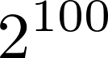
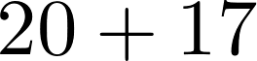
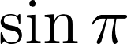
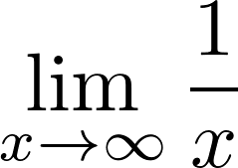
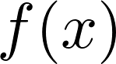
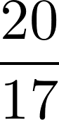
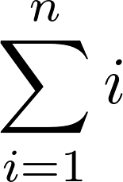
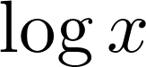
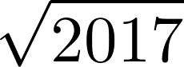
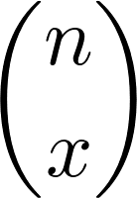
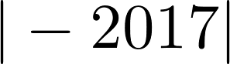
Demo
An expression describes a computation and evaluates to a value.

Slide 34
Call Expressions
Evaluation procedure for call expressions
Evaluate the operator
Evaluate the operands from left to right
Apply the operator (a function) to the evaluated operands (arguments)
add ( 2 , 3 )
Operator
Operand
Operand
Apply!
Operators and operands are also expressions
So they also evaluate to values

Slide 35
add(add(6, mul(4, 6)), mul(3, 5))
???
Notes:
Quick! Evaluate this! Shout out the answer!

Slide 36
Nested Call Expressions
Humans evaluate inside-out
add(add(6, mul(4, 6)), mul(3, 5))
add(add(6, 24 ), mul(3, 5))
add(add(6, 24 ), mul(3, 5))
add( 30 , mul(3, 5))
add( 30 , mul(3, 5))
add( 30 , 15 )
add( 30 , 15 )
45
We can jump ahead or skip around, but Python can't do that!
How does the computer know which call to evaluate first?

Slide 37
Nested Call Expressions
Evaluate operator Evaluate operands Apply!
1
2
3
45
add(add(6, mul(4, 6)), mul(3, 5))
add
30
15
add(6, mul(4, 6))
mul(3, 5)
24
add
6
mul(4, 6)
mul
3
5
mul
4
6
Expression Tree

Slide 38
Functions, Objects, & Interpreters
Demo
Notes:
Shakespeare demo

